Slide 1
Atlanta Market Lease Analysis

Slide 2
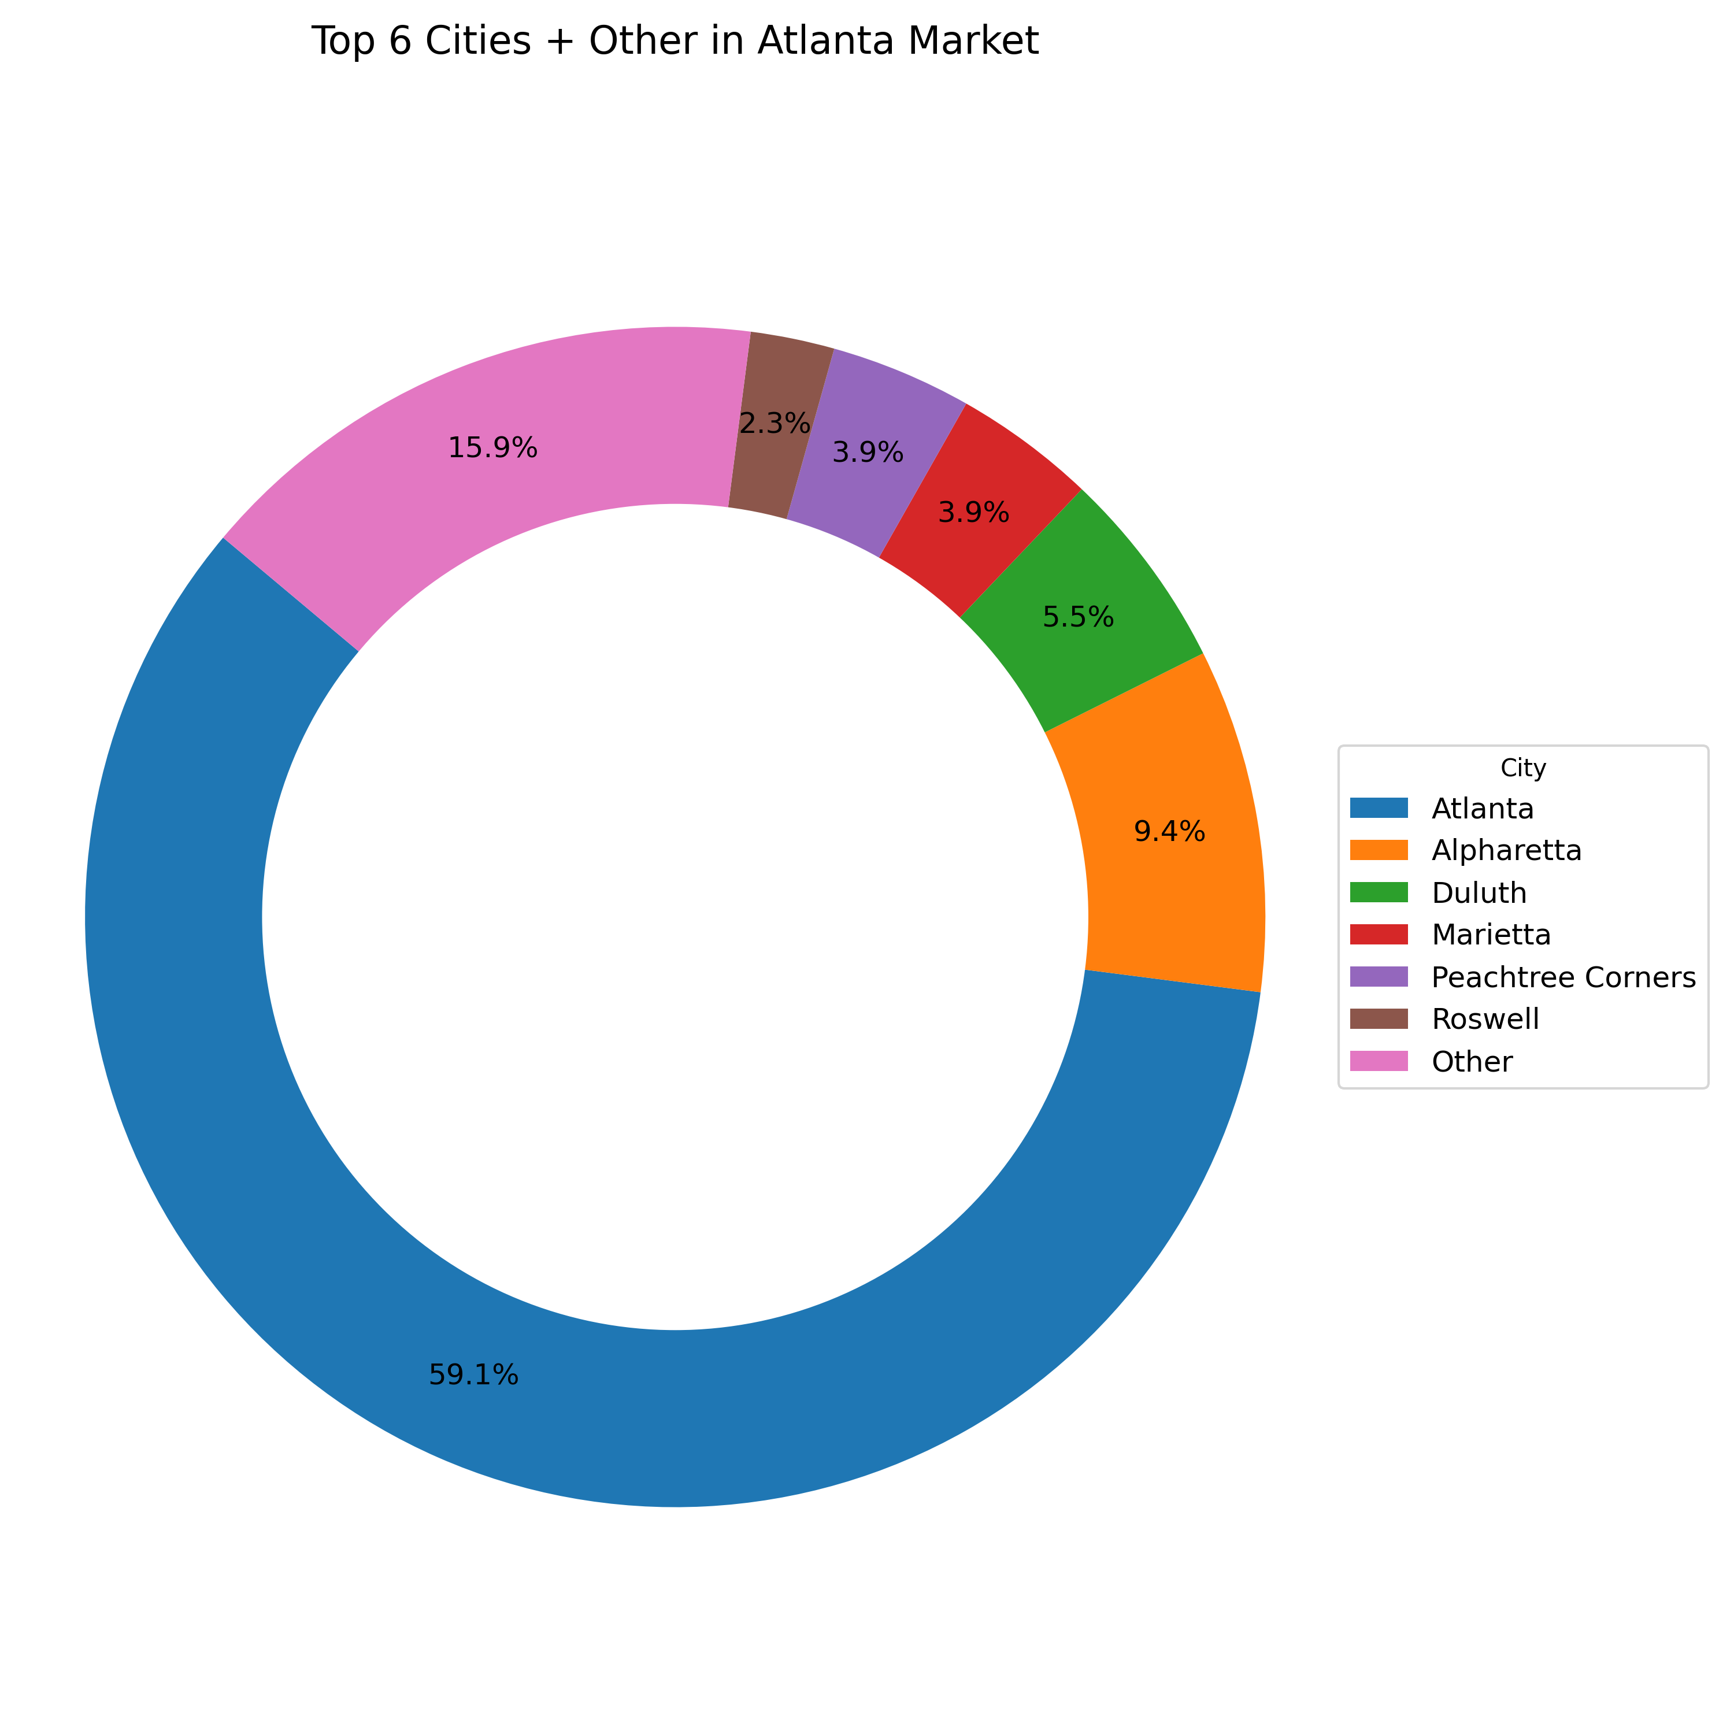
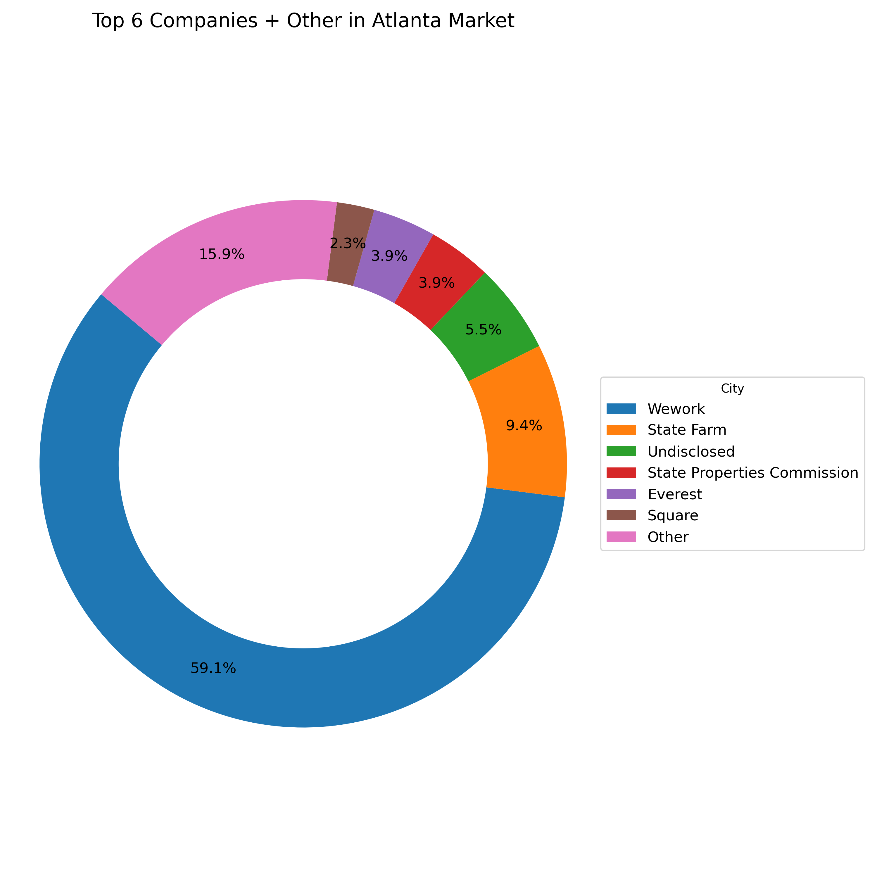
Background Information
What Atlanta Market has?
'Atlanta', 'Alpharetta', 'Duluth’’, “Marietta” Peachtree Corners’, ‘Roswell’
'Atlanta', 'Alpharetta', 'Duluth’’, “Marietta” Peachtree Corners’, ‘Roswell’
What companies in the Atlanta Market ?
'Wework', ‘state Farm', ‘Undisclosedcommission” ,”everest” ‘square’ ’’, “state properties

Slide 3
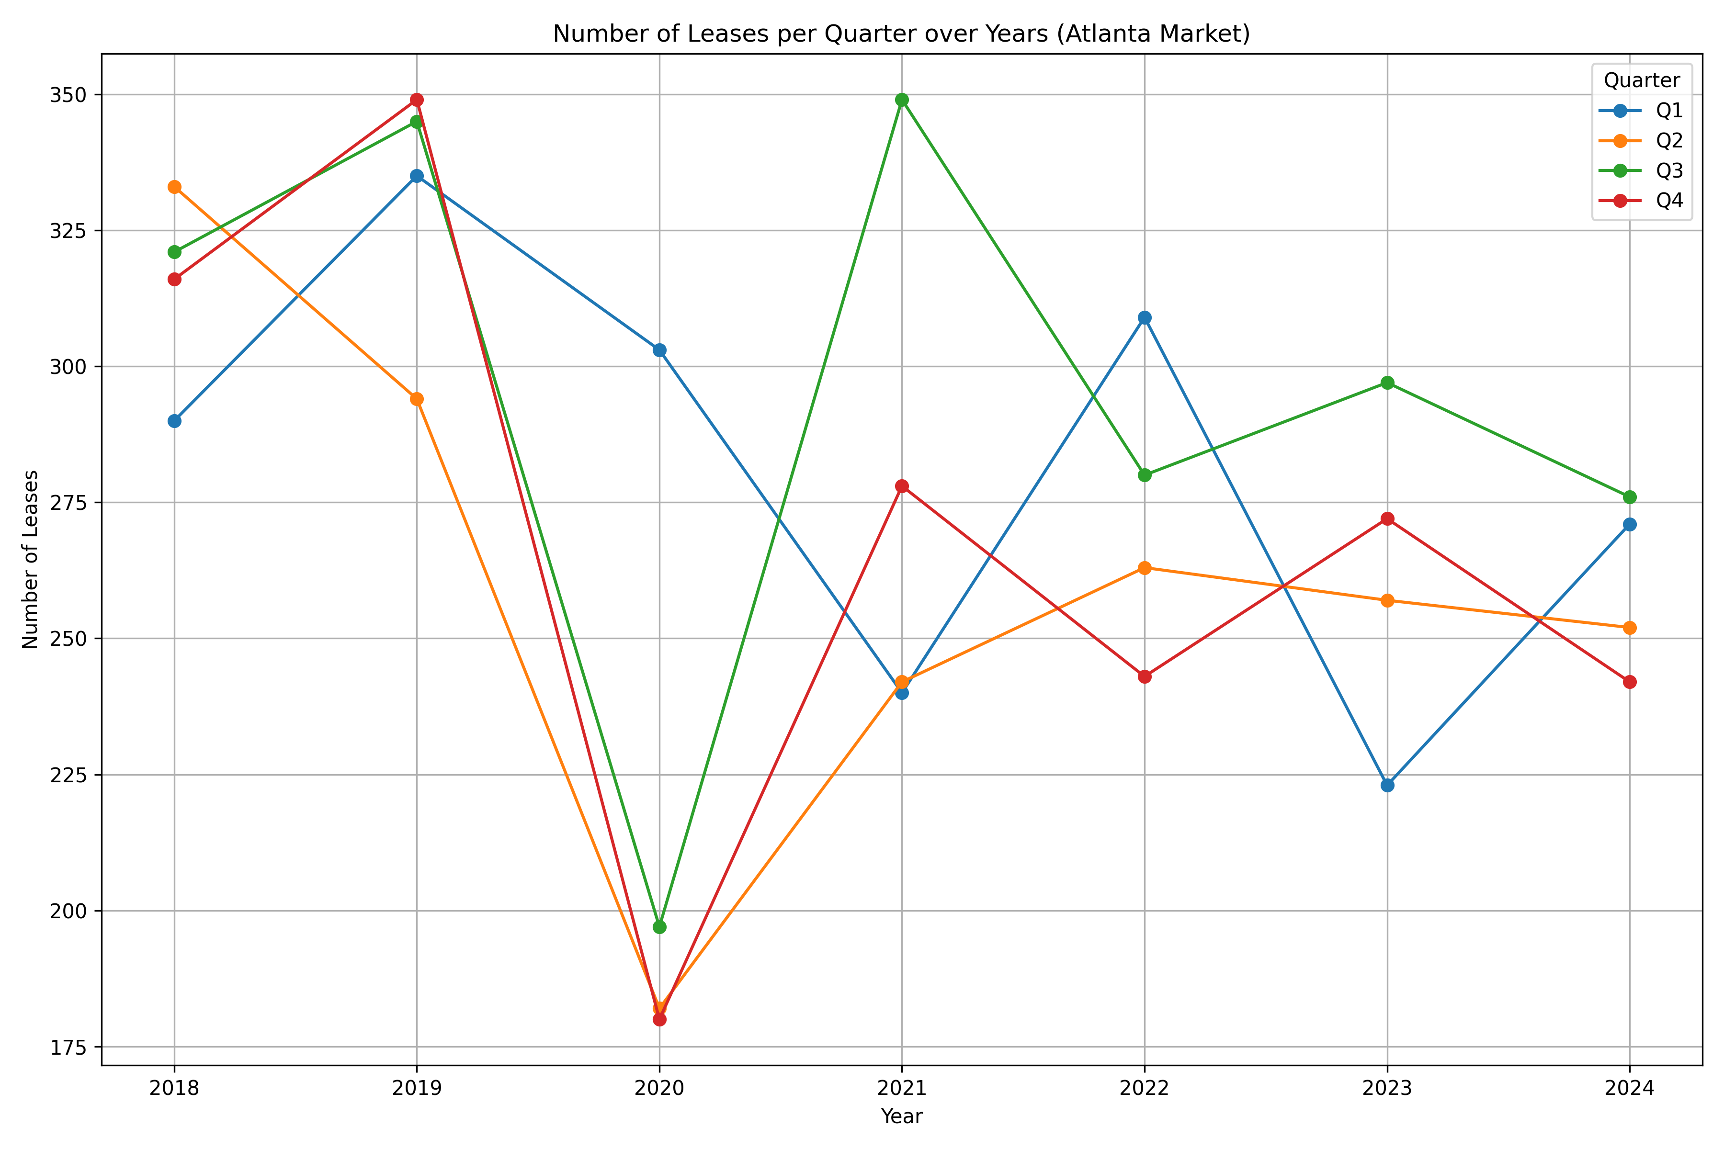
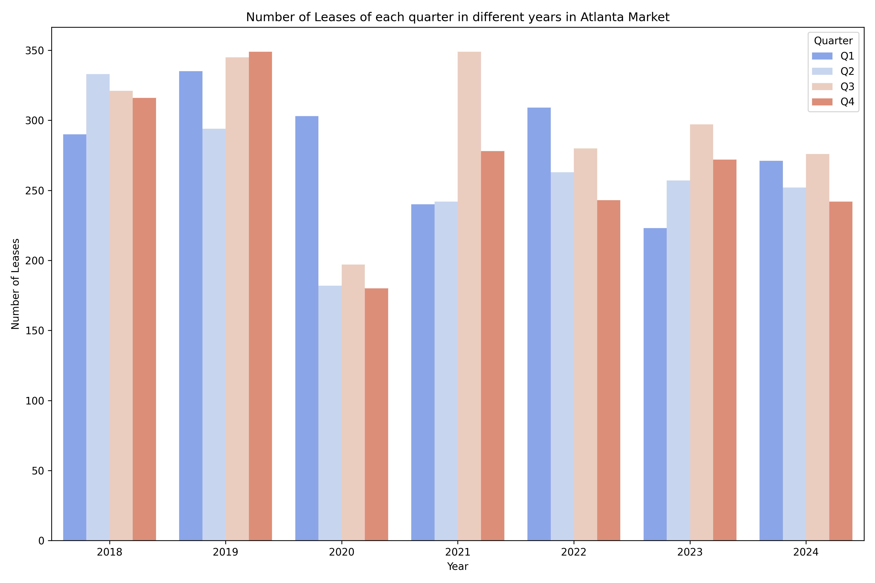

Slide 4
